Slide 1

Unit 5

Slide 2


To understand the passage on cartoons.
To read the passage using the time line.
To extract (提取) specific information from the reading passage.
To learn some new words and useful expressions.

Slide 3


Tell your partner what you like to watch and why.
A: What kind of movies or TV shows do you like? Why?
B: I like to watch … because they’re ... Do you like …?
A: I think they’re ... And I want to watch … because they’re …

Slide 4


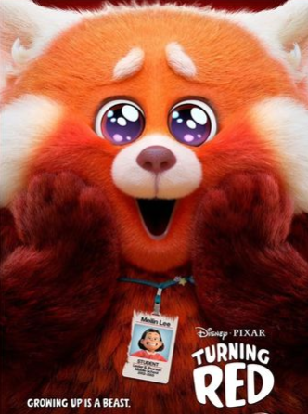
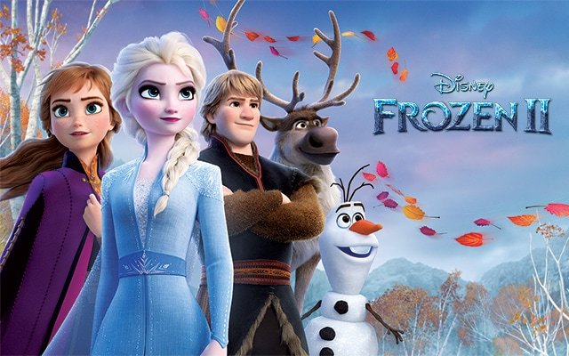

Do you like to watch cartoons? Why or why not?
wonderful, enjoyable, exciting, relaxing…

Slide 5
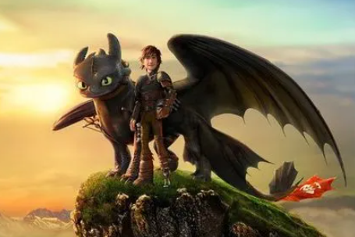
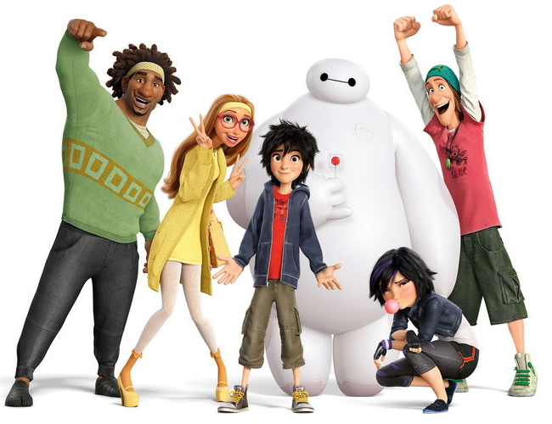
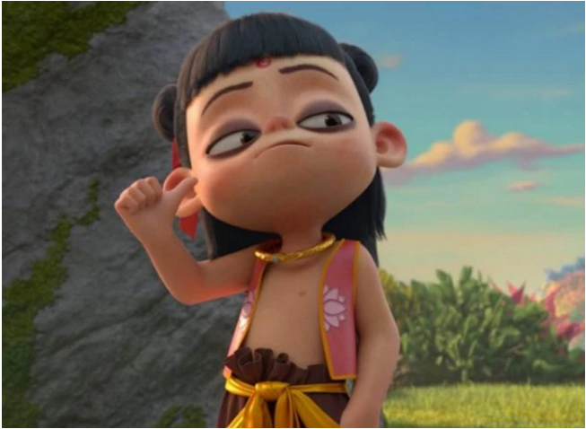
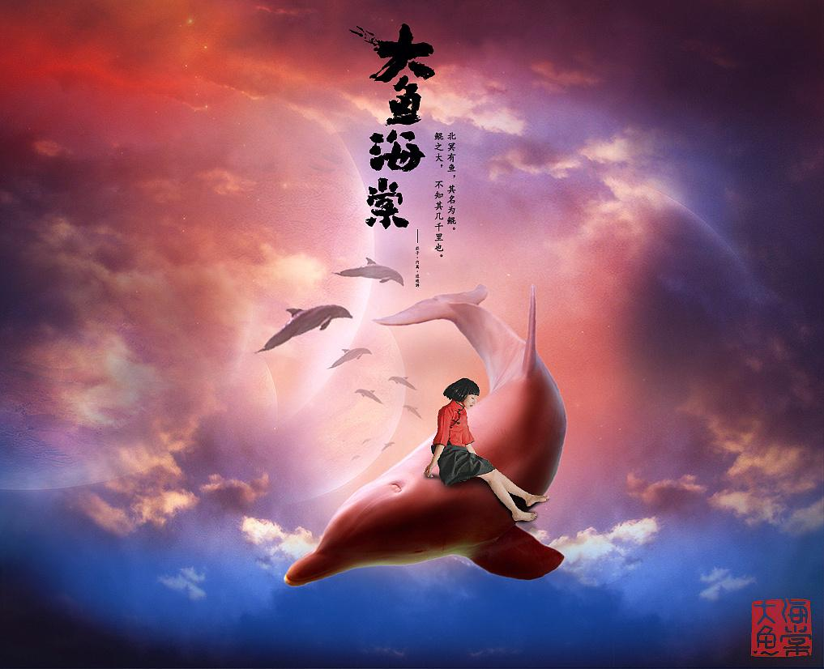
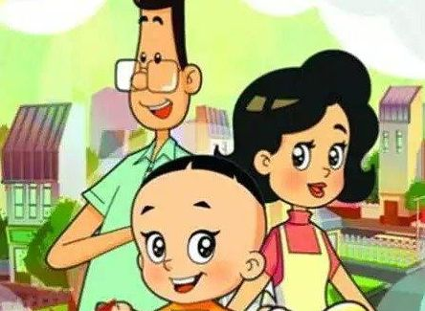
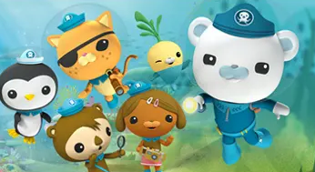
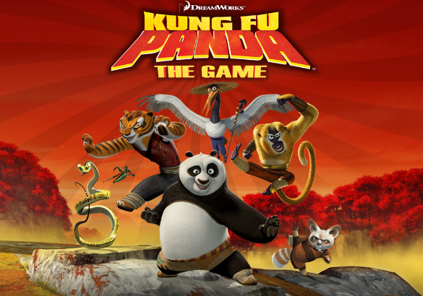
What is your favorite cartoon? Why do you like it? What are some characters in the cartoon?

Slide 6

Discuss the following questions with your partner.
Do you like to watch cartoons?
…
What’s your favorite cartoon?
…
Why do you like it?
…

Slide 7

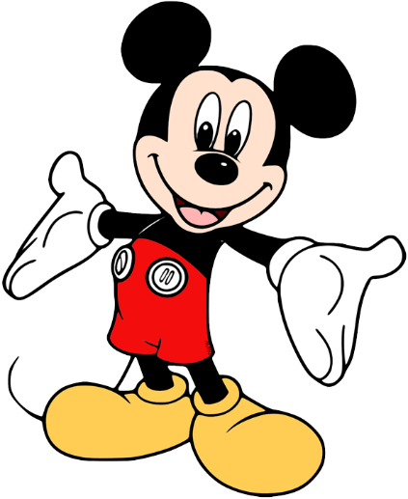


Listen and read the passage, then find the main idea.
adj.著名的; 出名的
1. Mickey Mouse, a famous symbol in American culture
2. Some Cartoons with Mickey Mouse
3. Disney theme parks around the world
4. What people think of cartoons
n.文化; 文明

Slide 8

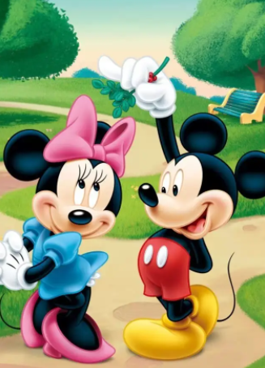
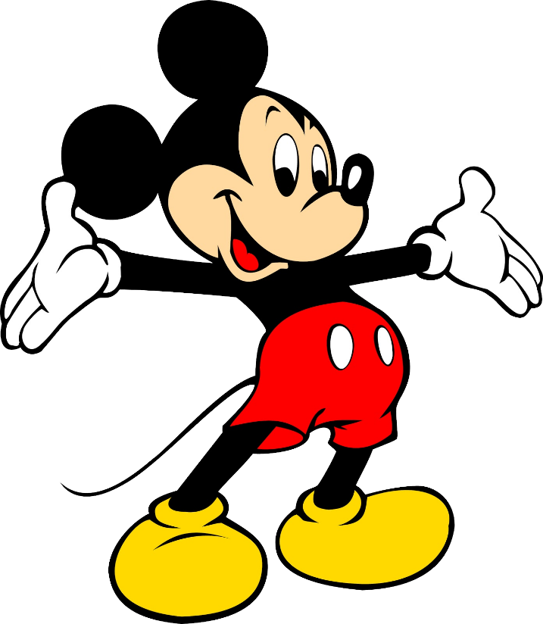
What do you think of Mickey Mouse? Can you think of some stories with Mickey Mouse?

Slide 9
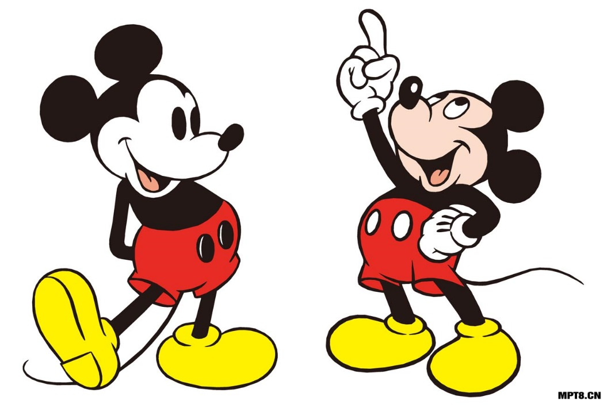
How much do you know about Mickey Mouse?
Mickey Mouse is a funny animal cartoon character and the mascot (吉祥物) of The Walt Disney Company. He was created by Walt Disney in 1928.

Slide 10
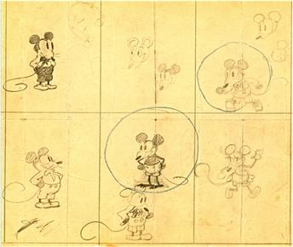
Concept(概念) art of Mickey from the collection of The Walt Disney Family Museum.

Slide 11

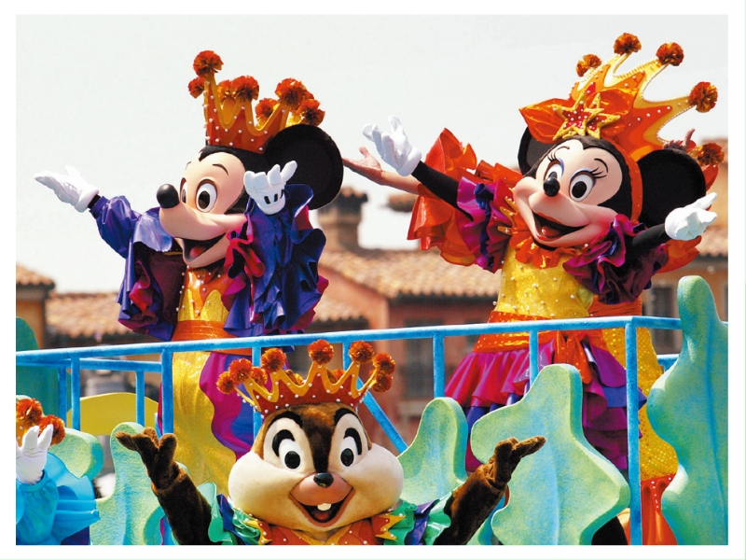
Look at the photo and guess what the passage may talk about.
Mickey Mouse, a famous symbol in American culture
Some cartoons with Mickey Mouse
Disney theme parks around the world
What people think of cartoons
This passage may talk about Disneyland or Mickey Mouse.

Slide 12
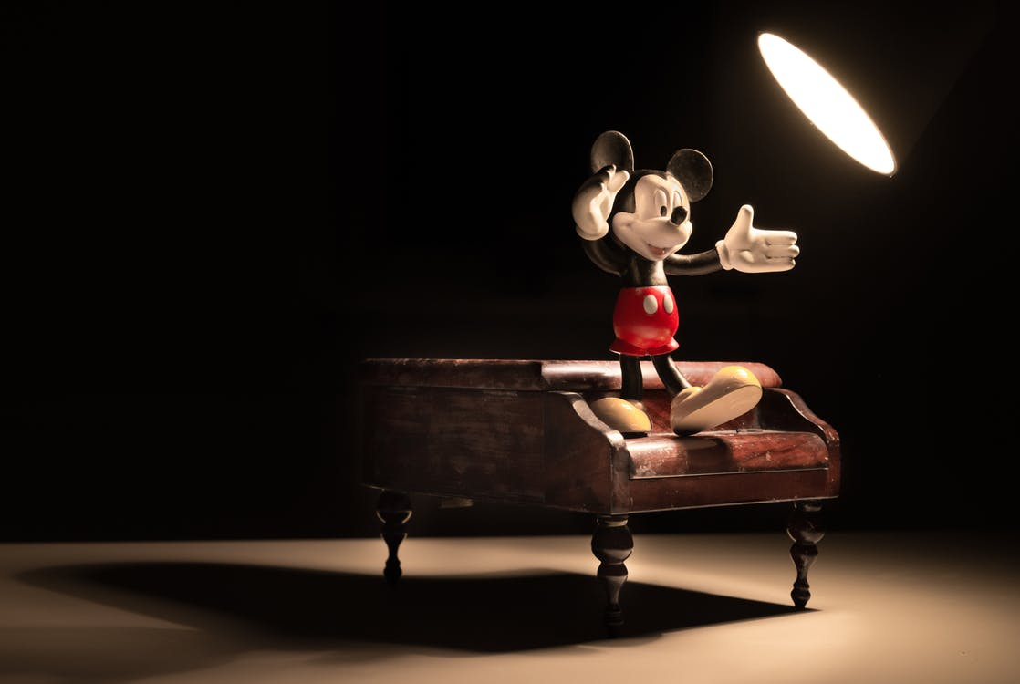
Unit 5
Do you want to watch a game show?

Slide 13
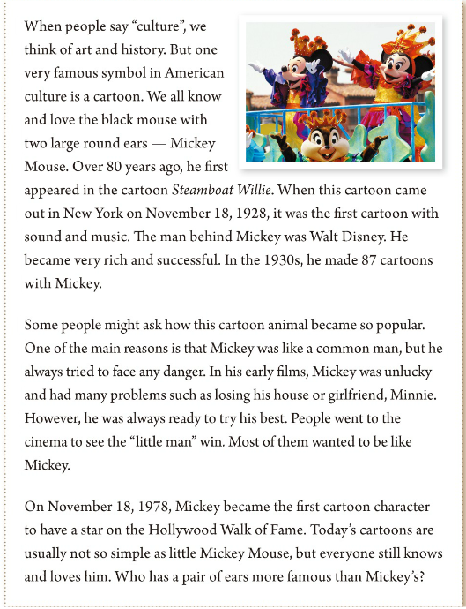
Look at the picture, guess what the article(文章) is about.
cartoon/Mickey Mouse/Disney

Slide 14
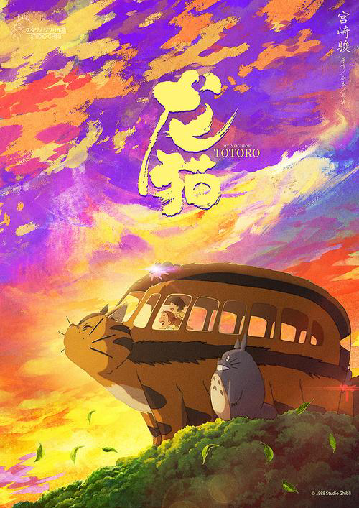
Let’s talk!
Do you like to watch cartoons?
What is your favorite cartoon?
Why do you like it?
Yes, I do.
My favorite cartoon is 《Totoro》.
Because it is a warm movie.
There I can see the beautiful countryside (乡村) and know how to get well along with (相处) the nature.

Slide 15
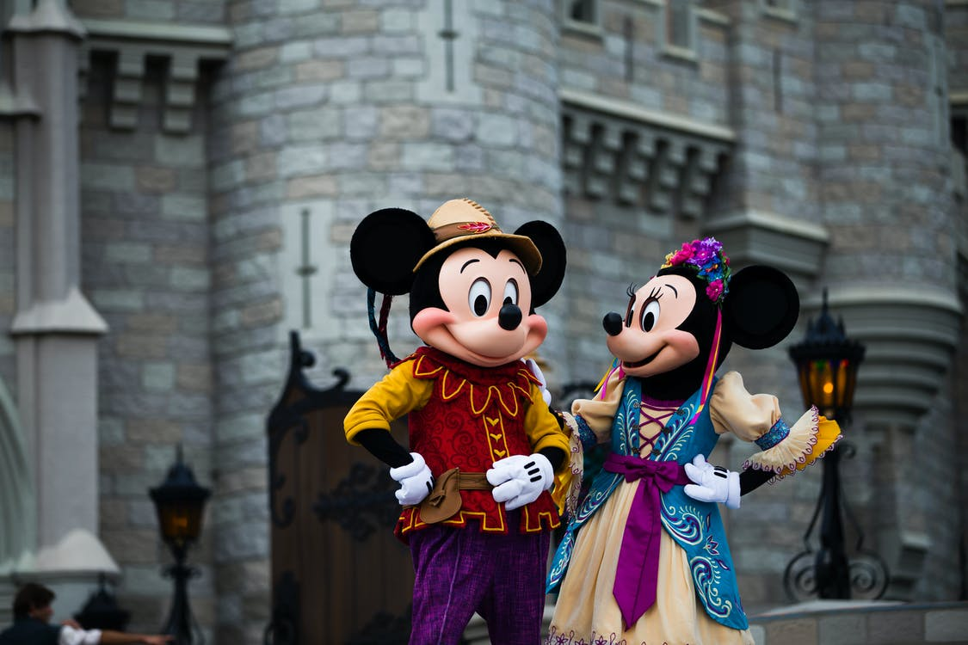

Reading

Slide 16
Listen to the passage, match each main idea with each paragragh and underline the time key words.
听并速读文章、匹配每段大意和划出时间标志词。（1分钟）
Para 1
The main reason why Mickey Mouse is popular.
主要的 原因
Para 2
Mickey Mouse’s achievements(成就).
Para 3
An introduction(介绍) to Mickey Mouse.
November 18, 1928
November 18, 1978
1930s

Slide 17

Time Key Words
Read the passage and complete the time line below.
n.人物；角色
Mickey became the first cartoon character to have a star on the Hollywood Walk of Fame.
Steamboat Willie came out in New York.
Walt Disney made 87 cartoons with Mickey Mouse.
好莱坞星光大道
November 18, 1928
November 18, 1978
1930s

Slide 18

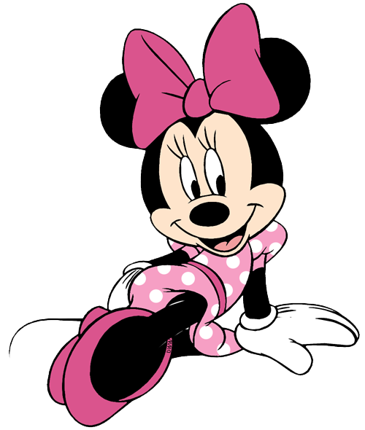
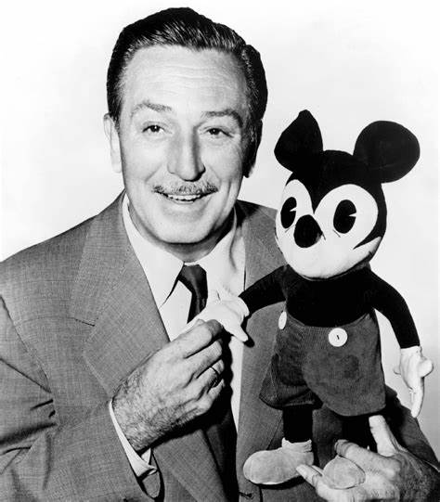
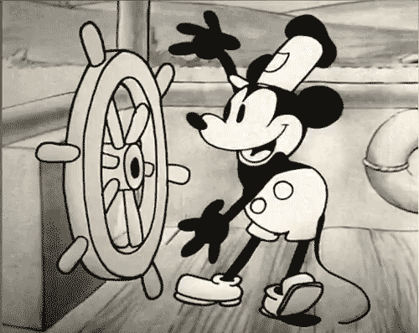
Read the paragraph 1 and 2 and fill in the facts about Mickey.
读1、2段并完成表格。(1分钟)
The introduction(介绍) and main reason why Mickey is popular.
 | What does he look like? | Who created him? | What was his first cartoon? | Who is his girlfriend? | Why is he popular?
Mickey Mouse
创造
He’s a black mouse with two large round ears.
Walt Disney
Steamboat Willie.
Minnie.
It was the first cartoon with sound and music.

Slide 19
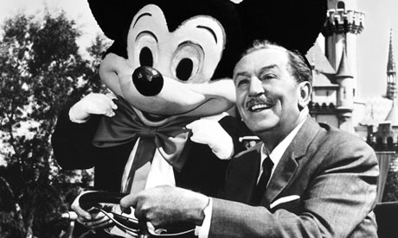
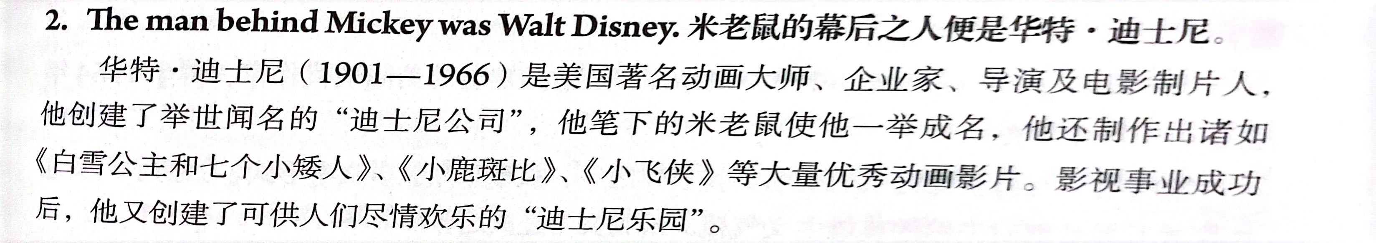
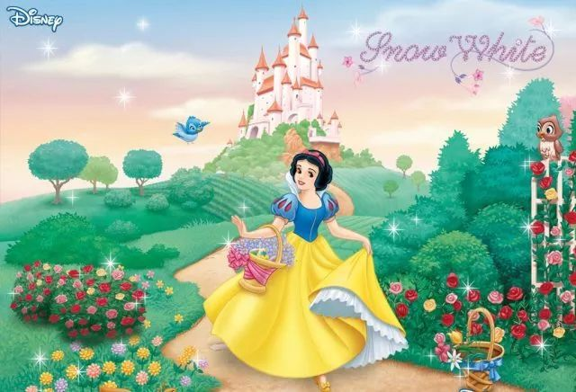
Walt Disney

Slide 20
Read the paragraph 1 and 2 and fill in the facts about Mickey.
读1、2段并完成表格。
He was like a common man, but always tried to face any danger.
He had many problems, but he was always ready to try his best.
People wanted to see the “little man” win.
People wanted to be like him.
The introduction(介绍) and main reason why Mickey is popular.
 | What does he look like? | Who created him? | What was his first cartoon? | Who is his girlfriend? | Why is he popular?
Mickey Mouse
创造
He’s a black mouse with two large round ears.
Walt Disney
Steamboat Willie.
Minnie.
It was the first cartoon with sound and music.

Slide 21
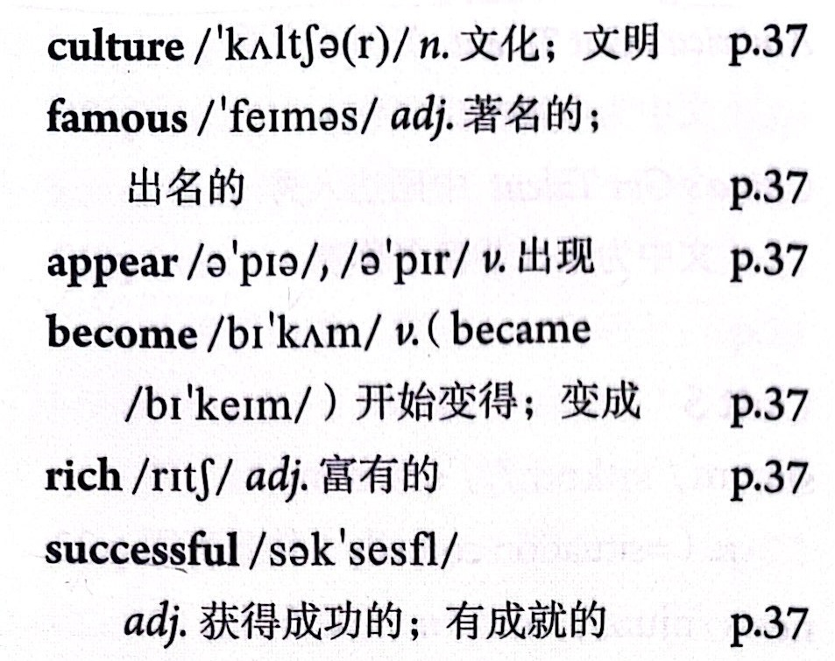
Para 1
An introduction(介绍) to Mickey Mouse.

Slide 22
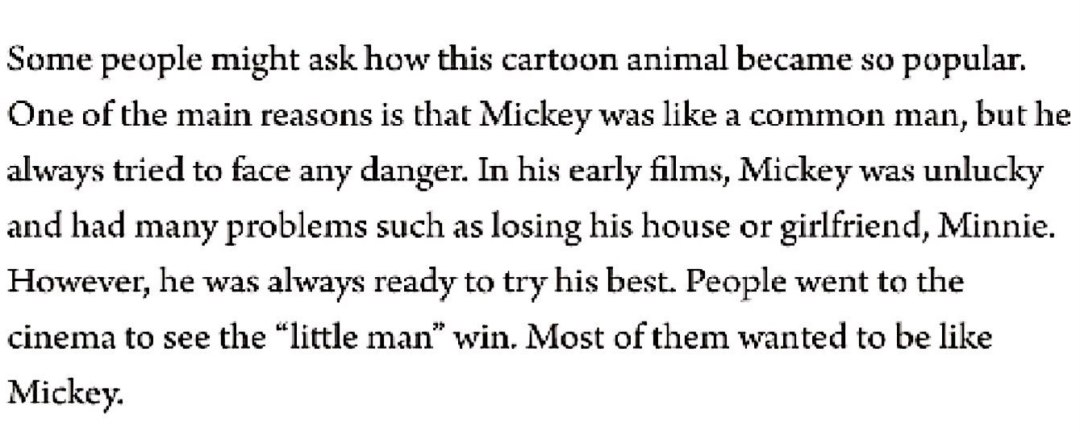
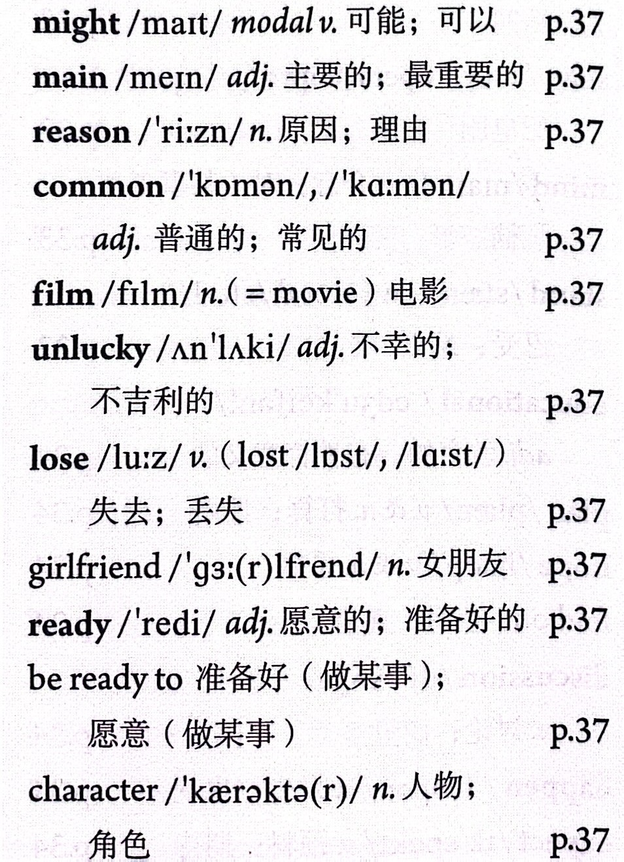
Para 2
The reason why Mickey Mouse is popular.

Slide 23

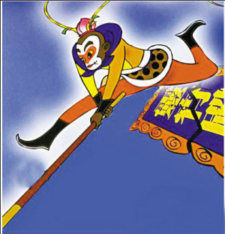
Read the passage carefully and discuss the questions with a partner.
精读文章并和同桌讨论以下问题。(1分钟)
1. What is Mickey Mouse a symbol of?
What cartoon character is a symbol of Chinese culture?
n.人物；角色
Mickey Mouse is a symbol of American culture(美国文化).
In my opinion, Monkey King/Su Wukong is a symbol of Chinese culture.
3. Why did people want to be like Mickey?
Do you want to be like Mickey? Why or why not?
Because Mickey always tried to face any danger. Sometimes he had many problems, but he was always ready to try his best and win.
Yes, I do. Because I want to face any problem in my life and am always ready to try my best and solve(解决) them like Mickey.

Slide 24
2. Do you think Walt Disney is a smart man?
Why or why not?
Do you want to be like him?
Yes, he is.
Because he knows that people like to see the “little man” win./
Because after Mickey’s success, he made 87 cartoons with Mickey.
No, I never expect to be a big man/successful businessman one day.
4. Can you think of another cartoon character that is as famous as Mickey? Why is the character popular?
Yes, Monkey King/Sun Wukong.
Because he is brave(勇敢的) and always ready to try his best to face any danger.

Slide 25
Para 1
An introduction(介绍) to Mickey Mouse.

Slide 26
Para 2
The reason why Mickey Mouse is popular.

Slide 27
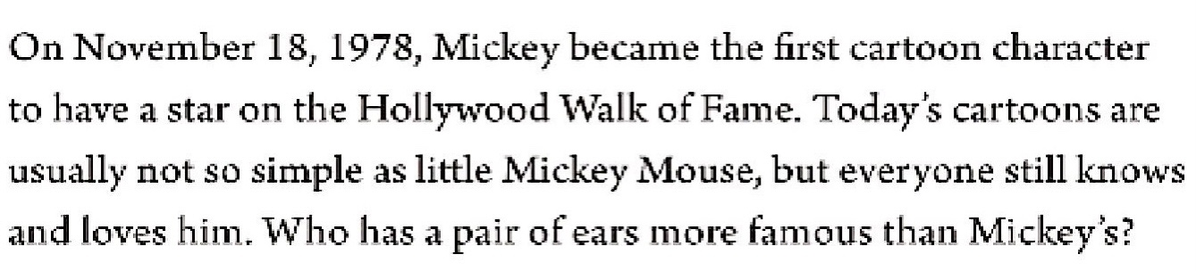
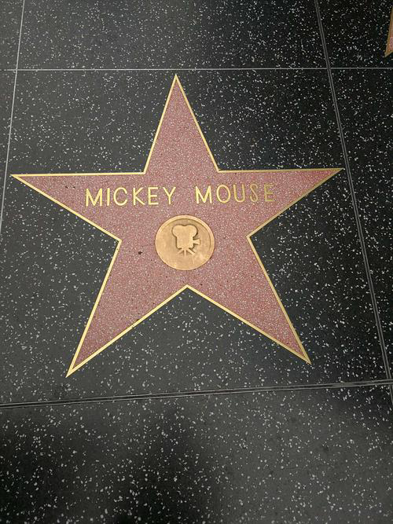
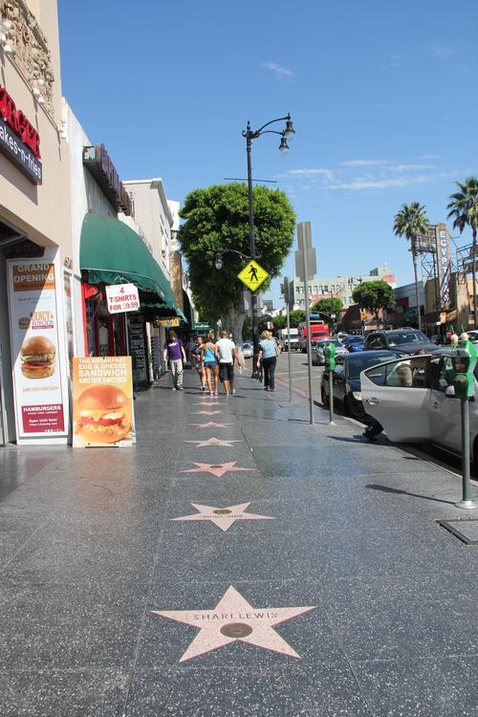
Para 3
Mickey Mouse’s achievements(成就).

Slide 28

Underline the following phrases in the passage. Write your own sentences or questions using the phrases.
think of, come out, one of the main reasons,
such as, was ready to, try his best
What do you think of talk shows?
That magazine comes out once a month.
One of the main reasons is that I am hard-working.
He knows four languages, such as Chinese and English.
Tom was always ready to help.
He tries his best to do the work.

Slide 30

( ) 1. Mickey Mouse is a symbol of American culture.
( ) 2. Steamboat Willie is the first cartoon with sound and music.
( ) 3. In his early films, Mickey was lucky.
( ) 4. Mickey became very hot on the Hollywood Walk of Fame in 1988.
T
T
F
unlucky
F
1978

Slide 31
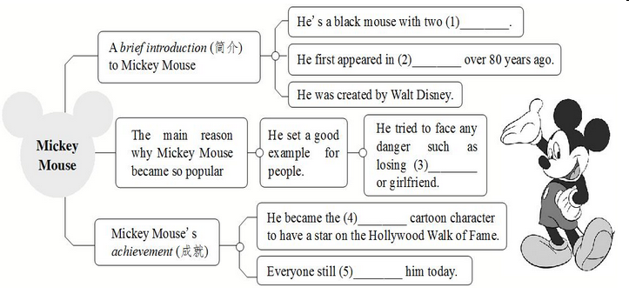
Read the passage carefully and complete the blanks.
large round ears
Steamboat Willie
his house
first
knows and loves

Slide 32
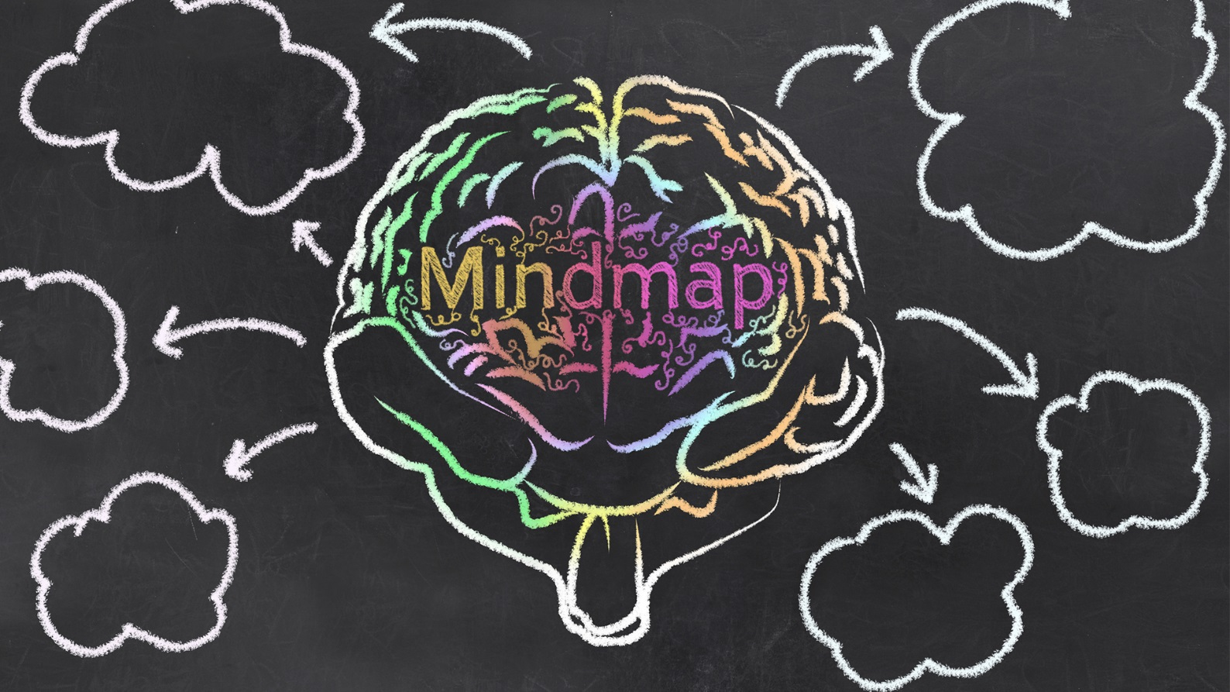
Try to retell the passage according to the mind-map.

Slide 33
the black mouse with two large round ears first appeared in the cartoon Steamboat Willie
Mickey Mouse
came out in …on…
the first cartoon with sound and music
created by Walt Disney
became very rich and successful
made 87 cartoons with Mickey
became popular
like a common man; try to face any danger; ready to try his best
on November 18, 1978
the first cartoon character to have a star
achievement
today
everyone still knows and loves him

Slide 34
想到；想起
n.文化
adj.著名的
come out
出版
在20世纪30年代

Slide 35
主要原因之一
adj.普通的；常见的
面对任何危险
例如
try one's best
尽力
be always ready to do sth. 总是准备好做某事；总是乐意 / 愿意做某事
be like 像

Slide 36


_______________________ 出版
_______________________ 想到；想起
cartoon with sound and music ________________________
in the 1930s ________________________
_______________________ 主要原因之一
_______________________ 面对任何危险
_______________________ 总是准备好做某事；
总是乐意 / 愿意做某事
________________________ 尽力
come out
think of
带有配音和音乐的卡通片
在20世纪30年代
one of the main reasons
face any danger
be always ready to do sth.
try one’s best

Slide 37


Ⅰ. 根据句意及所给汉语提示，写出所缺单词。
1. These two countries have different ______________ (文化). We should respect (尊重) them.
2. We missed him, but he never ______________ (出现) again.
3. In recent (最近) years, shopping online is ______________ (开始变得) more and more popular in our lives.
4. Usually face-to-face meetings are ______________(获得成功的) than e-mails and phone calls.
5. Lisa didn’t come to my birthday party for some ______________ (理由).
cultures
appeared
becoming
more successful
reasons

Slide 38
Ⅱ.根据语境从方框中选择恰当单词填空。每词限用一次。
1. Many children are interested in cartoons. However, some parents think cartoons ___________.
2. The ___________ person is not the happiest person.
3. Mickey Mouse and Donald Duck are both ___________ characters in the Disney cartoon.
4. His name was Wang Qiang, a(n) ___________ name in China.
lucky, rich, common, famous, main, meaning, lose, film
meaningless
richest
main
common

Slide 39
lucky, rich, common, famous, main, meaning, lose, film
5. Sarah often watches ___________ or her favorite shows on TV in rainy weather.
6. —Peter ran to the bus stop but still missed the last bus.
—How ___________ he was!
7. A friend is easier ___________ than found.
8. Many people like her songs. She is ____________ as a singer than as a writer.
films
unlucky
lost
more famous

Slide 40
Ⅲ. 根据汉语意思，完成英语句子，每空一词。
1. For me, it’s _______ _________ _______(像……一样简单) ABC.
2. Who is your favorite _______ _______ _______(动作影片明星)?
3. It’s 5:30. We _______ _______ _______ _______ _______(准备好回家) now.
4. We didn’t recognize (认出) the criminal, because he _______ _______ _______ _______ _______ (装扮成了学生的样子).
as simple/easy as
action movie star
are ready to go home
dressed
up like/as a student

Slide 41
5. Can you help me find someone to _______ _______ _______ (代替Helen)?
6. They finished the job on time and _______ _______ _______ _______(干得好).
7. This newspaper _______ _______(出版) every Thursday.
8. I will enjoy my life and _______ _______ _______(尽力) to do everything well.
take Helen’s place
did a good
job
comes out
try my best

Slide 42


1. Retell the passage and write it down.
2. List the words, phrases and important sentences of this lesson.

Slide 43


